Slide 1
Graph
Prepared by : Irfan Sofyana Putra

Slide 2
What will we discuss today?
Graph (definition and terminology)
Graph (representation)
Graph Traversal Algorithm (DFS and BFS)
Topological Sort
Minimum Spanning Tree
Shortest Path Algorithm

Slide 3
Graph
Graph is use for representing discrete objects and the relation of it.
Typically, a graph is depicted in diagrammatic form as a set of dots or circles for the vertices, joined by lines or curves for the edges.

Slide 4
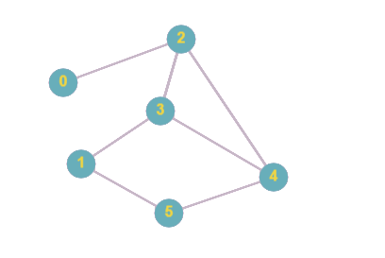
Example
Graph with 6 vertex and 7 edges.

Slide 5
Terminology
Vertice / Node
Edges
Directed / Undirected
Degree
Cycle
Path
Tree
Forest

Slide 6
Vertice/Node
Represent an object in graph.
Usually denoted by circle or something like that.
A point of interection
There are 6 nodes in that graph

Slide 7
Edges
Represent a relation between two nodes/vertices.
Usually denoted by a line that connect two node / vertices.
There are 7 edges in beside graph:
Edge connect node 0 and 2
Edge connect node 2 and 3
Edge connect node 2 and 4
Edge connect node 3 and 4
Edge connect node 3 and 1
Edge connect node 1 and 5
Edge connect node 4 and 5

Slide 8
Adjacent
Two different nodes are said to be adjacent if they are directly connected.
Node 2 is adjacent with node 0 but node 1 is not adjacent with node 0

Slide 9
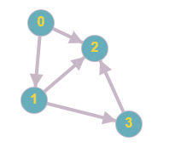
Directed Graph
A directed graph is graph i.e., a set of objects (called vertices or nodes) that are connected together, where all the edges are directed from one vertex to another.
Example:

Slide 10
Undirected Graph
An undirected graph is graph, i.e., a set of objects (called vertices or nodes) that are connected together, where all the edges are bidirectional.
Example;

Slide 11
Degree
Degree of a node is a number of edge incident to that node.
Degree of node 3 is 3
Degree of node 0 is 1
Degree of node 5 is 2

Slide 12
Path
a path in a graph is a finite or infinite sequences of edges which connect a sequence of vertices / node which, by most definitions, are all distinct from one another
Example path :
0, 2, 3, 4
3, 1, 5, 4

Slide 13
Cycle
a cycle is a path of edges and vertices wherein a vertex is reachable from itself
Example cycle:
2, 4, 3, 2
2, 4, 5, 1, 3, 2
3, 4, 5, 1, 3

Slide 14
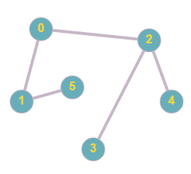
Tree
Tree is an undirected graph in which any two vertices are connected by exactly one path.
Because of that, Tree will not contain any cycle.
Not a tree
Tree

Slide 15
How to Represent Graph?
In competitive programming, there are 3 ways that are usually used to store a graph. They are:
Adjacency Matrix
Edge list
Adjacency List

Slide 16
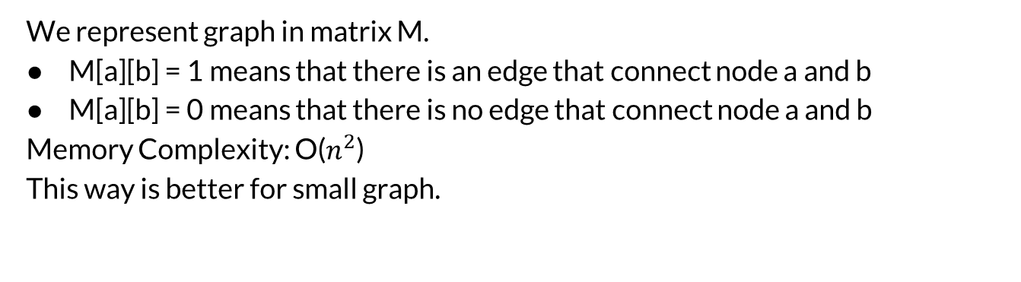
Adjacency Matrix
We represent graph in matrix M.
M[a][b] = 1 means that there is an edge that connect node a and b
M[a][b] = 0 means that there is no edge that connect node a and b
Memory Complexity: O($n^{2}$)
This way is better for small graph.

Slide 17
Adjacency Matrix
Matrix M:
Index from 0
0 | 0 | 1 | 0 | 0 | 0
0 | 0 | 0 | 1 | 0 | 1
1 | 0 | 0 | 1 | 1 | 0
0 | 1 | 1 | 0 | 1 | 0
0 | 0 | 1 | 1 | 0 | 1
0 | 1 | 0 | 0 | 1 | 0

Slide 18
Edge List
An edge list contains all edges of a graph in some order.
This is a convenient way to represent a graph if the algorithm processes all edges of the graph and it is not needed to find edges that start at a given node.
The edge list can be stored in a vector
vector<pair<int,int>> v;

Slide 19
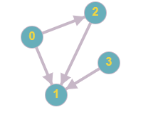
Edge List
v.push_back({0, 2})
v.push_back({0, 1})
v.push_back({2, 1})
v.push_back({3, 1})

Slide 20
Adjacency List
The best way to store a graph
In the adjacency list representation, each node x in the graph is assigned an adjacency list that consists of nodes to which there is an edge from x.
It use a vector to store the adjacency list.
vector<int> v[N];
N : the number of vertices/node in graph

Slide 21
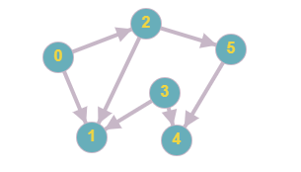
Adjacency List
To declare that there is an edge connect node a and b we use v[a].push_back(b)
So for the graph beside,
V[0].push_back(1)
V[0].push_back(2)
V[2].push_back(1)
V[2].push_back(5)
V[3].push_back(1)
V[3].push_back(4)
V[5].push_back(4)
To check all edge from node a we use:
for (int i = 0; i < v[a].size(); i++){
int adjacent_node_a = v[a][i];
//process
}

Slide 22
Graph Traversal
Suppose we need to traverse a graph. Then we can use two general algorithms to do that.
They are DFS and BFS.

Slide 23
DFS
DFS stands for Depth First Search
Simple algorithm for traversing a graph. It’s start from a distinguished source vertex, DFS will traverse the graph “Depth First”.
Everytime DFS hits a branching point (a vertex with more than one neighbors), DFS will choose one of the unvisited neighbor(s) and visit this neighbor vertex.
DFS repeats this process and goes deeper until it reaches a vertex where it cannot go any deeper.
When this happens, DFS will ‘backtrack’ and explore another unvisited neighbor(s), if any.

Slide 24
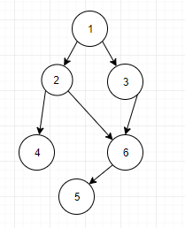
Example
DFS start from 1

Slide 25
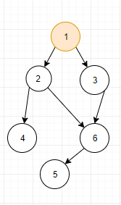

Slide 26
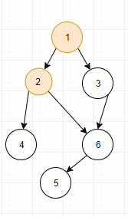

Slide 27
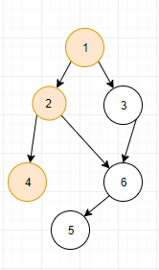

Slide 28
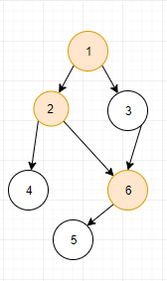

Slide 29
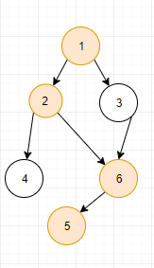

Slide 30
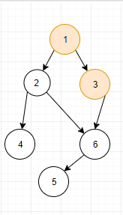

Slide 31
DFS
So the traversal order from 1 with DFS algorithm is : 1, 2, 4, 6, 5, 3

Slide 32
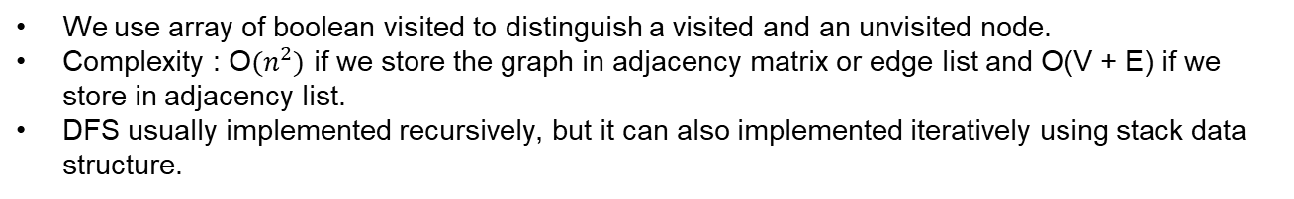
Implementation
void dfs(int node){
visited[node] = true;
/*check all neighbours of current node */
for (int i = 0; i < adjacent[node].size(); i++){
int neighbour = adjacent[node][i];
/* if we haven’t visit the neighbour, visit that node!*/
if (!visited[neighbour])
dfs(neighbour);
}
}
We use array of boolean visited to distinguish a visited and an unvisited node.
Complexity : O$(n^{2})$ if we store the graph in adjacency matrix or edge list and O(V + E) if we store in adjacency list.
DFS usually implemented recursively, but it can also implemented iteratively using stack data structure.

Slide 33
Application
Find Connected Component
Flood Fill
Topological Sort
And many other problems ....

Slide 34
BFS
BFS stands for breadth first search.
Starting from a distinguished source vertex, BFS will traverse the graph ‘breadth-first’.
That is, BFS will visit vertices that are direct neighbors of the source vertex (first layer), neighbors of direct neighbors (second layer), and so on, layer by layer.

Slide 35
BFS
BFS starts with the insertion of the source vertex s into a queue, then processes the queue as follows: Take out the front most vertex u from the queue, enqueue all unvisited neighbors of u (usually, the neighbors are ordered based on their vertex numbers), and mark them as visited.
With the help of the queue, BFS will visit vertex s and all vertices in the connected component that contains s layer by layer.

Slide 36
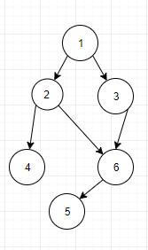
Example
BFS start from 1

Slide 37


Slide 38
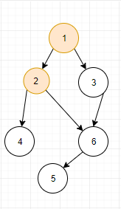

Slide 39
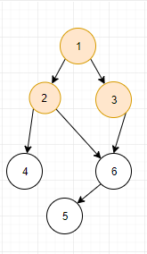

Slide 40
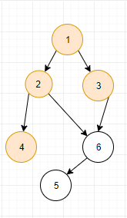

Slide 41
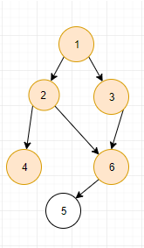

Slide 42
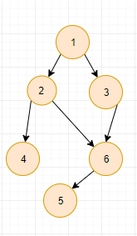

Slide 43
BFS
So the traversal order from 1 with BFS algorithm is : 1, 2, 3, 4, 6, 5

Slide 44
Implementation
queue<int> q;
bool visited[N];
q.push(start);
visited[start] = true;
While (!q.empty()) {
int now = q.front(); q.pop();
for (int i = 0; i <adj[now].size(); i++){
int neighbour = adj[now][i];
if (!visited[neighbour]){
visited[neighbour] = true;
q.push(neighbour);
}
}
}

Slide 45
Application
Unweighted Single Source Shortest Path
Find Connected Component
And many other problems ...

Slide 46
Topological Sort
In computer science, a topological sort or topological ordering of a directed graph is a linear of its vertices such that for every directed edge u-v from vertex u to vertex v, u comes before v in the ordering.
A topological ordering is possible if and only if the graph has no directed cycles.

Slide 47
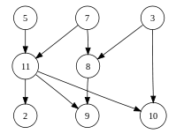
Example
The graph shown to the left has many valid topological sorts, including:
5, 7, 3, 11, 8, 2, 9, 10 (visual left-to-right, top-to-bottom)
3, 5, 7, 8, 11, 2, 9, 10 (smallest-numbered available vertex first)
5, 7, 3, 8, 11, 10, 9, 2 (fewest edges first)
7, 5, 11, 3, 10, 8, 9, 2 (largest-numbered available vertex first)
5, 7, 11, 2, 3, 8, 9, 10 (attempting top-to-bottom, left-to-right)
3, 7, 8, 5, 11, 10, 2, 9 (arbitrary)

Slide 48
Implementation
To find a topological sort we can use a DFS algorithm with some modification.
vector<int> order //vector to store the toposort in reverse order
void dfs(int node){
visited[node] = true;
for (int i = 0; i < Adj[node].size(); i++){
int neighbour = adj[node][i];
if (!visited[neighbour])
dfs(neighbour);
}
order.push_back(node); //this is only the difference with normal dfs!
}

Slide 49
Minimum Spanning Tree
A subset of the edges of a connected, edge-weighted undirected graph that connects all the vertices together, without any cycles and with the minimum possible total edge weight.
The cost of the spanning tree is the sum of the weights of all the edges in the tree. There can be many spanning trees. Minimum spanning tree is the spanning tree where the cost is minimum among all the spanning trees. There also can be many minimum spanning trees.

Slide 50
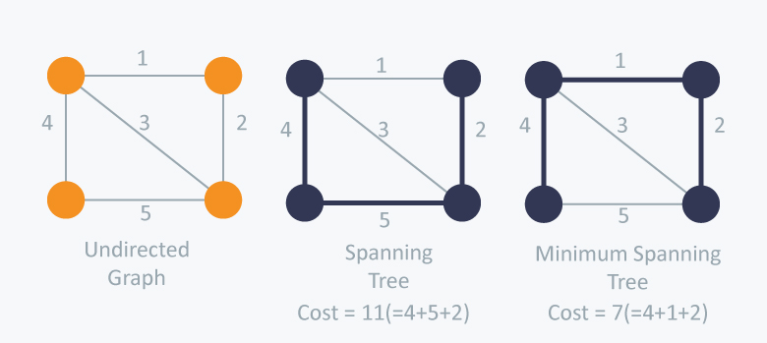
Minimum Spanning Tree

Slide 51
Minimum Spanning Tree
There are two famous algorithms for finding minimum spanning tree:
Prim’s Algorithm
Kruskal Algorithm

Slide 52
Prim’s Algorithm
Prim’s Algorithm also use Greedy approach to find the minimum spanning tree. In Prim’s Algorithm we grow the spanning tree from a starting position.
Algorithms:
1. Maintain two disjoint sets of vertices. One containing vertices that are in the growing spanning tree and other that are not in the growing spanning tree.
2. Select the cheapest vertex that is connected to the growing spanning tree and is not in the growing spanning tree and add it into the growing spanning tree. This can be done using Priority Queues. Insert the vertices, that are connected to growing spanning tree, into the Priority Queue.
3. Check for cycles. To do that, mark the nodes which have been already selected and insert only those nodes in the Priority Queue that are not marked.

Slide 53
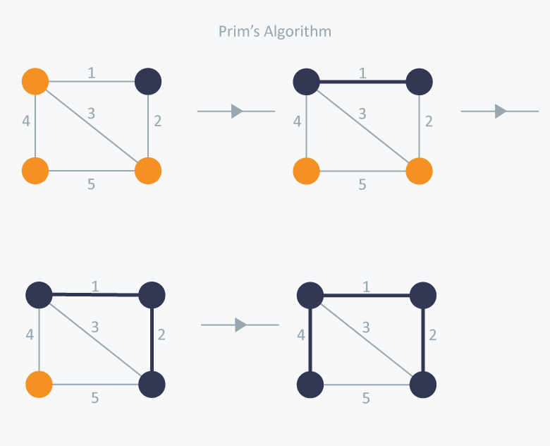
Example

Slide 54
Implementation
int prim(int start){
priority_queue<pair<int,int>, vector<pair<int,int>>, greater<pair<int,int>> > pq;
int minCost = 0;
pq.push({0, start});
while (!pq.empty()){
//select the edge with minimum weight
int weightEdge = pq.top().first;
int nowEdge = pq.top().second; pq.pop();
//checking for cycle
if (marked[nowEdge]) continue;
minCost += weightEdge;
marked[nowEdge] = true;
for (int i = 0; i < adj[nowEdge].size(); i++){
int neighbour = adj[nowEdge][i].second;
if (!marked[neighbour])
pq.push(adj[nowEdge][i]);
}
return minCost;
}

Slide 55
Implementation
There is a little bit implementation in adjacency list. For prim’s we must keep the weight of an edge.
So, if there is an edge between node a and node b with weight c, we do
adj[a].push_back({c, b});
adj[b].push_back({c, a});

Slide 56
Kruskal Algorithm
Will be discussed in 5th week!

Slide 57
Shortest Path
Single Source Shortest Path Unweighted Graph
Single Source Shortest Path Weighted Graph
Single Source Shortest Path Weighted Graph With Negative Weight Cycle
All Pair Shortest Path

Slide 58
Single Source Shortest Path Unweighted Graph
Just do BFS.

Slide 59
Single Source Shortest Path Weighted Graph
Use Dijkstra Algorithm
Similar to prim’s algorithm in MST Problem.
Algorithm:
1. Mark your selected initial node with a current distance of 0 and the rest with infinity.
2. Set the non-visited node with the smallest current distance as the current node C.
3. For each neighbour N of the current node C : add the current distance of C with the weight of the edge connecting (C-N). If it’s smaller than the current distance of N, set it as the current distance of N.
4. Mark the current node C as visited.
5. If there are non-visited nodes, go to step 2.
Complexity : O(E log V)
E is the number of edges and V is the number of vertices.

Slide 60
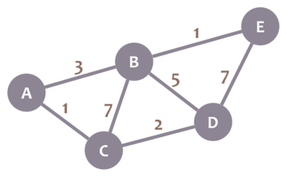
Example

Slide 61
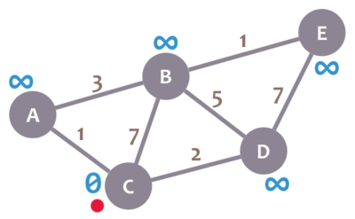
Start from node C

Slide 62
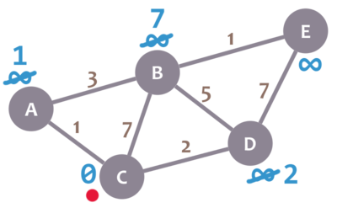

Slide 63
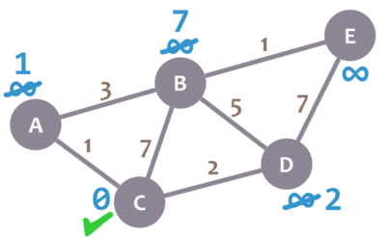

Slide 64
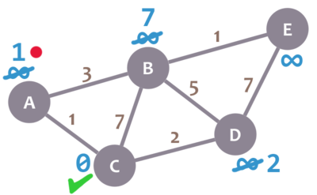

Slide 65
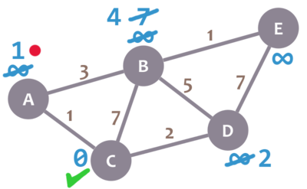

Slide 66
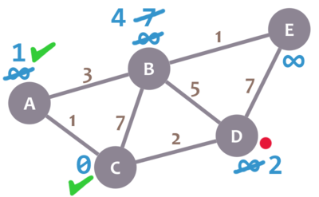

Slide 67
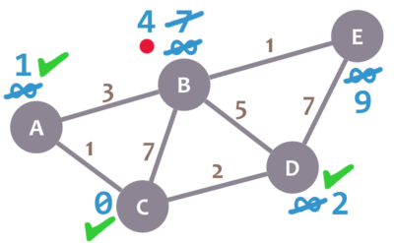

Slide 68
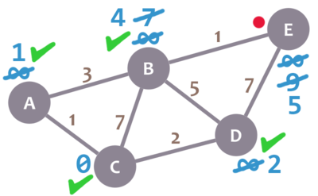

Slide 69
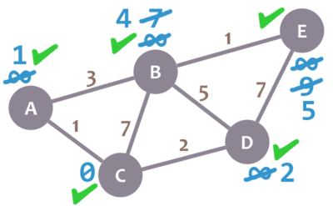

Slide 70
Implementation Dijkstra Algorithm
//initialization dist with infinite
vector<int> dist(V, INF);
priority_queue<pair<int,int>, vector<pair<int,int>>, greater<pair<int,int>> > pq;
pq.push({0, start});
dist[start] = 0;
while (!pq.empty()){
pair<int,int> front = pq.top(); pq.pop();
//u is current node
//d is current distance of node u
int d = front.first; int u = front.second;
if (d > dist[u]) continue;
for (int i = 0; i < adj[u].size(); i++){
int neighbour = adj[u][i].first;
int edgeConnect = adj[u][i].second;
if (dist[u] + edgeConnect < dist[neighbour]){
dist[neighbour] = dist[u] + edgeConnect;
pq.push({dist[neighbour], neighbour});
}
}
}

Slide 71
Single Source Shortest Path Weighted Graph With Negative Weight Cycle
We will not discuss this topic because this problem is usually rarely appear in programming contest.
But fyi, to solve this problem we use Bellman-Ford Algorithm

Slide 72
All Pair Shortest Path
Suppose we are given a graph. Find the shortest Path between every pair of vertices in the graph.
Can be done with Floyd-Warshall Algorithm.

Slide 73
Floyd-Warshall Algorithm
The algorithm maintains a two-dimensional array that contains distances between the nodes
First, the distances are calculated only using direct edges between the nodes.
After this the algorithm reduces the distances by using intermediate nodes in the paths.

Slide 74
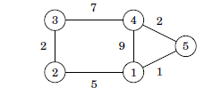
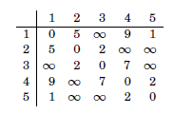
Example
Matrix

Slide 75
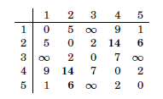
First Round (node 1 is the new intermediate )
There is a new path between nodes 2 and 4 with length 14, because node 1 connects them. There is also a new path between nodes 2 and 5 with length 6.

Slide 76
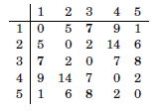
Second Round (node 2 is the new intermediate node)
This creates new paths between nodes 1 and 3 and between nodes 3 and 5

Slide 77
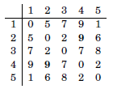
On the third round, node 3 is the new intermediate round. There is a new path between nodes 2 and 4:

Slide 78
The algorithm continues like this, until all nodes have been appointed intermediate nodes. After the algorithm has finished, the matrix contains the minimum distances between any two nodes.

Slide 79

Implementation
Initialization:
for (int i = 1; i<= n; i++)
for (int j = 1; j <= n; j++){
if (i == j) dist[i][j] = 0;
else if (v[i][j] > 0) dist[i][j] = v[i][j];
else dist[i][j] = 1000000000 //set INF
}
Algorithm:
for (int k = 1; k <= n; k++)
for (int i = 1; i <= n; i++)
for (int j = 1; j <= n; j++)
dist[i][j] = min(dist[i][j], d[i][k] + d[k][j]);
Complexity : O($n^{3}$)

Slide 80
Thank You

